Slide 1
Dynamic Programming

Slide 2
What is Dynamic Programming?
Dynamic programming is a very powerful, general tool for solving optimization problems.
Once understood it is relatively easy to apply, but many people have trouble understanding it.
Why not Greedy?
Greedy algorithms focus on making the best local choice at each decision point.
For example, a natural way to compute a shortest path from x to y might be to walk out of x, repeatedly following the cheapest edge until we get to y. WRONG!
In the absence of a correctness proof, greedy algorithms are very likely to fail.

Slide 3
Example 1 – Fibonacci number generation
Problem:
Let’s consider the calculation of Fibonacci numbers:
F(n) = F(n-2) + F(n-1)
with seed values F(1) = 1, F(2) = 1
or F(0) = 0, F(1) = 1
What would a series look like:
0, 1, 1, 2, 3, 4, 5, 8, 13, 21, 34, 55, 89, 144, …

Slide 4
Example 1 – Fibonacci number generation
Recursive Algorithm:
Fib(n)
{
if (n == 0)
return 0;
if (n == 1)
return 1;
Return Fib(n-1)+Fib(n-2)
}

Slide 5
Example 1 – Fibonacci number generation
Recursive Algorithm:
Fib(n)
{
if (n == 0)
return 0;
if (n == 1)
return 1;
Return Fib(n-1)+Fib(n-2)
}
It has a serious issue!

Slide 6
Example 1 – Fibonacci number generation
Recursion tree
What’s the problem?

Slide 7
Example 1 – Fibonacci number generation
Memoization:
Fib(n)
{
if (n == 0)
return M[0];
if (n == 1)
return M[1];
if (Fib(n-2) is not calculated)
call Fib(n-2);
if(Fib(n-1) is not calculated)
call Fib(n-1);
//Store the ${n}^{th}$ Fibonacci no. in memory & use previous results.
M[n] = M[n-1] + M[n-2]
Return M[n];
}

Slide 8
Example 1 – Fibonacci number generation
already calculated …

Slide 9
Dynamic programming - Approach
Main approach: recursive, holds answers to a sub problem in a table, can be used without recomputing.
Can be formulated both via recursion and saving results in a table (memoization). Typically, we first formulate the recursive solution and then turn it into recursion plus dynamic programming via memoization or bottom-up.
”programming” as in tabular not programming code

Slide 10
Elements of Dynamic Programming
Optimal Substructure
An optimal solution to a problem contains within it an optimal solution to subproblems
Optimal solution to the entire problem is build in a bottom-up manner from optimal solutions to subproblems
Overlapping Subproblems
If a recursive algorithm revisits the same subproblems over and over ⇒ the problem has overlapping subproblems

Slide 11
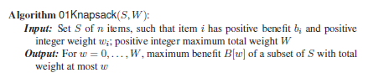
0-1 Knapsack – DP approach

Slide 12
0-1 Knapsack – Algorithm
for w=0 to W do
B[w] = 0
for k=1 to n do
{
for j=W downto w_{k} do
{
if B[j-w_{k}]+b_{k} > B[j]
{ B[j]= B[j-w_{k}]+b_{k}
keep[k, j] = 1
}
else
keep[k, j] = 0
}
}
k=W
for i = n downto 1 do
{
if keep[i, k] == 1
{
output i “as selected”
k = k-w_{i}
}
}

Slide 13
0-1 Knapsack – Example 1
Find the solution for the 0-1 knapsack problem with benefit-weight pairs as (10, 5), (40, 4), (30, 6), (50, 3) and total sack capacity as 10.
Initialize the benefit array
Initialize the keep array
Solve using DP approach

Slide 14
0-1 Knapsack – Example 1
Find the solution for the 0-1 knapsack problem with benefit-weight pairs as (10, 5), (40, 4), (30, 6), (50, 3) and total sack capacity as 10.
B[0] | 0
B[1] | 0
B[2] | 0
B[3] | 0
B[4] | 0
B[5] | 0
B[6] | 0
B[7] | 0
B[8] | 0
B[9] | 0
B[10] | 0
 | 0 | 1 | 2 | 3 | 4 | 5 | 6 | 7 | 8 | 9 | 10
1
2
3
4
Initialize the Keep array
Initialize the Benefit array

Slide 15

0-1 Knapsack – Algorithm
for w=0 to W do
B[w] = 0
for k=1 to n do
{
for j=W downto w_{k} do
{
if B[j-w_{k}]+b_{k} > B[j]
{ B[j]= B[j-w_{k}]+b_{k}
keep[k, j] = 1
}
else
keep[k, j] = 0
}
}
k=W
for i = n downto 1 do
{
if keep[i, k] == 1
{
output i “as selected”
k = k-w_{i}
}
}

Slide 16
0-1 Knapsack – Example 1
Find the solution for the 0-1 knapsack problem with benefit-weight pairs as (10, 5), (40, 4), (30, 6), (50, 3) and total sack capacity as 10.
B[0] | 0
B[1] | 0
B[2] | 0
B[3] | 0
B[4] | 0
B[5] | 0
B[6] | 0
B[7] | 0
B[8] | 0
B[9] | 0
B[10] | 0
 | 0 | 1 | 2 | 3 | 4 | 5 | 6 | 7 | 8 | 9 | 10
1
2
3
4
Initialize the Keep array
Initialize the Benefit array

Slide 17
0-1 Knapsack – Example 1
Find the solution for the 0-1 knapsack problem with benefit-weight pairs as (10, 5), (40, 4), (30, 6), (50, 3) and total sack capacity as 10.
B[0] | 0
B[1] | 0
B[2] | 0
B[3] | 0
B[4] | 0
B[5] | 0 | 10
B[6] | 0 | 10
B[7] | 0 | 10
B[8] | 0 | 10
B[9] | 0 | 10
B[10] | 0 | 10
 | 0 | 1 | 2 | 3 | 4 | 5 | 6 | 7 | 8 | 9 | 10
1 |  |  |  |  |  | 1 | 1 | 1 | 1 | 1 | 1
2
3
4
Keep array

Slide 18
0-1 Knapsack – Example 1
Find the solution for the 0-1 knapsack problem with benefit-weight pairs as (10, 5), (40, 4), (30, 6), (50, 3) and total sack capacity as 10.
B[0] | 0
B[1] | 0
B[2] | 0
B[3] | 0
B[4] | 0 |  | 40
B[5] | 0 | 10 | 40
B[6] | 0 | 10 | 40
B[7] | 0 | 10 | 40
B[8] | 0 | 10 | 40
B[9] | 0 | 10 | 50
B[10] | 0 | 10 | 50
 | 0 | 1 | 2 | 3 | 4 | 5 | 6 | 7 | 8 | 9 | 10
1 |  |  |  |  |  | 1 | 1 | 1 | 1 | 1 | 1
2 |  |  |  |  | 1 | 1 | 1 | 1 | 1 | 1 | 1
3
4
Keep array

Slide 19
0-1 Knapsack – Example 1
Find the solution for the 0-1 knapsack problem with benefit-weight pairs as (10, 5), (40, 4), (30, 6), (50, 3) and total sack capacity as 10.
B[0] | 0
B[1] | 0
B[2] | 0
B[3] | 0
B[4] | 0 |  | 40
B[5] | 0 | 10 | 40
B[6] | 0 | 10 | 40
B[7] | 0 | 10 | 40
B[8] | 0 | 10 | 40
B[9] | 0 | 10 | 50
B[10] | 0 | 10 | 50 | 70
 | 0 | 1 | 2 | 3 | 4 | 5 | 6 | 7 | 8 | 9 | 10
1 |  |  |  |  |  | 1 | 1 | 1 | 1 | 1 | 1
2 |  |  |  |  | 1 | 1 | 1 | 1 | 1 | 1 | 1
3 |  |  |  |  |  |  | 0 | 0 | 0 | 0 | 1
4
Keep array

Slide 20
0-1 Knapsack – Example 1
Find the solution for the 0-1 knapsack problem with benefit-weight pairs as (10, 5), (40, 4), (30, 6), (50, 3) and total sack capacity as 10.
B[0] | 0
B[1] | 0
B[2] | 0
B[3] | 0 |  |  |  | 50
B[4] | 0 |  | 40 |  | 50
B[5] | 0 | 10 | 40 |  | 50
B[6] | 0 | 10 | 40 |  | 50
B[7] | 0 | 10 | 40 |  | 90
B[8] | 0 | 10 | 40 |  | 90
B[9] | 0 | 10 | 50 |  | 90
B[10] | 0 | 10 | 50 | 70 | 90
 | 0 | 1 | 2 | 3 | 4 | 5 | 6 | 7 | 8 | 9 | 10
1 |  |  |  |  |  | 1 | 1 | 1 | 1 | 1 | 1
2 |  |  |  |  | 1 | 1 | 1 | 1 | 1 | 1 | 1
3 |  |  |  |  |  |  | 0 | 0 | 0 | 0 | 1
4 |  |  |  | 1 | 1 | 1 | 1 | 1 | 1 | 1 | 1
Keep array
Maximum Profit

Slide 21
0-1 Knapsack – Algorithm
for w=0 to W do
B[w] = 0
for k=1 to n do
{
for j=W downto w_{k} do
{
if B[j-w_{k}]+b_{k} > B[j]
{ B[j]= B[j-w_{k}]+b_{k}
keep[k, j] = 1
}
else
keep[k, j] = 0
}
}
k=W
for i = n downto 1 do
{
if keep[i, k] == 1
{
output i “as selected”
k = k-w_{i}
}
}

Slide 22
0-1 Knapsack – Example 1
I1 - (10, 5), I2 - (40, 4), I3 - (30, 6), I4 - (50, 3)
 | 0 | 1 | 2 | 3 | 4 | 5 | 6 | 7 | 8 | 9 | 10
1 |  |  |  |  |  | 1 | 1 | 1 | 1 | 1 | 1
2 |  |  |  |  | 1 | 1 | 1 | 1 | 1 | 1 | 1
3 |  |  |  |  |  |  | 0 | 0 | 0 | 0 | 1
4 |  |  |  | 1 | 1 | 1 | 1 | 1 | 1 | 1 | 1
k=10
i=4 to 1
When i=4, keep[4,10]==1??
Yes, pick item 4, k=10-3 = 7
When i=3, keep[3,7]==1??
No
When i=2, keep[2,7]==1??
Yes, pick item 2, k=7-4 = 3
When i=1, keep[1,3]==1?? No
Final Solution, [0, 1, 0, 1] = 90

Slide 23
0-1 Knapsack – Algorithm
for w=0 to W do
B[w] = 0
for k=1 to n do
{
for j=W downto w_{k} do
{
if B[j-w_{k}]+b_{k} > B[j]
{ B[j]= B[j-w_{k}]+b_{k}
keep[k, j] = 1
}
else
keep[k, j] = 0
}
}
k=W
for i = n downto 1 do
{
if keep[i, k] == 1
{
output i “as selected”
k = k-w_{i}
}
}
Complexity??
O(nW)

Slide 24
0-1 Knapsack – Example 2
Consider the given benefit-weight list for four items as {1, 4, 5, 7} and {1, 3, 4, 5}. Solve the 0-1 knapsack problem assuming W=7.
B[0] | 0
B[1] | 0
B[2] | 0
B[3] | 0
B[4] | 0
B[5] | 0
B[6] | 0
B[7] | 0
 | 0 | 1 | 2 | 3 | 4 | 5 | 6 | 7
1
2
3
4
Keep array
Benefit array

Slide 25
0-1 Knapsack – Example 2
Consider the given benefit-weight list for four items as {1, 4, 5, 7} and {1, 3, 4, 5} respectively. Solve the 0-1 knapsack problem assuming W=7.
B[0] | 0
B[1] | 0 | 1
B[2] | 0 | 1
B[3] | 0 | 1
B[4] | 0 | 1
B[5] | 0 | 1
B[6] | 0 | 1
B[7] | 0 | 1
 | 0 | 1 | 2 | 3 | 4 | 5 | 6 | 7
1 |  | 1 | 1 | 1 | 1 | 1 | 1 | 1
2
3
4
Keep array
Benefit array

Slide 26
0-1 Knapsack – Example 2
Consider the given benefit-weight list for four items as {1, 4, 5, 7} and {1, 3, 4, 5} respectively. Solve the 0-1 knapsack problem assuming W=7.
B[0] | 0
B[1] | 0 | 1
B[2] | 0 | 1
B[3] | 0 | 1 | 4
B[4] | 0 | 1 | 5
B[5] | 0 | 1 | 5
B[6] | 0 | 1 | 5
B[7] | 0 | 1 | 5
 | 0 | 1 | 2 | 3 | 4 | 5 | 6 | 7
1 |  | 1 | 1 | 1 | 1 | 1 | 1 | 1
2 |  |  |  | 1 | 1 | 1 | 1 | 1
3
4
Keep array
Benefit array

Slide 27
0-1 Knapsack – Example 2
Consider the given benefit-weight list for four items as {1, 4, 5, 7} and {1, 3, 4, 5} respectively. Solve the 0-1 knapsack problem assuming W=7.
B[0] | 0
B[1] | 0 | 1
B[2] | 0 | 1
B[3] | 0 | 1 | 4
B[4] | 0 | 1 | 5
B[5] | 0 | 1 | 5 | 6
B[6] | 0 | 1 | 5 | 6
B[7] | 0 | 1 | 5 | 9
 | 0 | 1 | 2 | 3 | 4 | 5 | 6 | 7
1 |  | 1 | 1 | 1 | 1 | 1 | 1 | 1
2 |  |  |  | 1 | 1 | 1 | 1 | 1
3 |  |  |  |  | 0 | 1 | 1 | 1
4
Keep array
Benefit array

Slide 28
0-1 Knapsack – Example 2
Consider the given benefit-weight list for four items as {1, 4, 5, 7} and {1, 3, 4, 5} respectively. Solve the 0-1 knapsack problem assuming W=7.
B[0] | 0
B[1] | 0 | 1
B[2] | 0 | 1
B[3] | 0 | 1 | 4
B[4] | 0 | 1 | 5
B[5] | 0 | 1 | 5 | 6 | 7
B[6] | 0 | 1 | 5 | 6 | 8
B[7] | 0 | 1 | 5 | 9
 | 0 | 1 | 2 | 3 | 4 | 5 | 6 | 7
1 |  | 1 | 1 | 1 | 1 | 1 | 1 | 1
2 |  |  |  | 1 | 1 | 1 | 1 | 1
3 |  |  |  |  | 0 | 1 | 1 | 1
4 |  |  |  |  |  | 1 | 1 | 0
Keep array
Maximum Profit
Benefit array

Slide 29
0-1 Knapsack – Example 1
I1 - (1, 1), I2 - (4, 3), I3 - (5, 4), I4 - (7, 5)
 | 0 | 1 | 2 | 3 | 4 | 5 | 6 | 7
1 |  | 1 | 1 | 1 | 1 | 1 | 1 | 1
2 |  |  |  | 1 | 1 | 1 | 1 | 1
3 |  |  |  |  | 0 | 1 | 1 | 1
4 |  |  |  |  |  | 1 | 1 | 0
k=7
i=4 to 1
When i=4, keep[4,7]==1??
No
When i=3, keep[3,7]==1??
Yes, pick item 3, k=7-4 = 3
When i=2, keep[2,3]==1??
Yes, pick item 2, k=3-3 = 0
When i=1, keep[1,0]==1?? No
Final Solution, [0, 1, 1, 0] = 9

Slide 30
Matrix Chain Multiplication
Finding the most efficient way to multiply a given sequence of matrices.
The problem is not actually to perform the multiplications, but merely to decide the sequence of the matrix multiplications involved.
Matrix chain multiplication is an optimization problem.

Slide 31
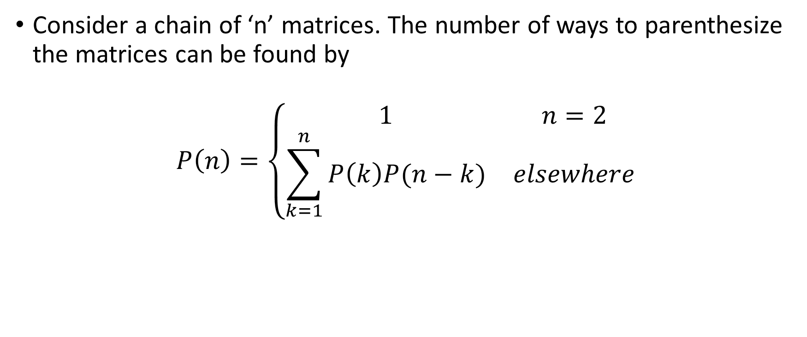
Parenthesizing the matrices
Consider a chain of ‘n’ matrices. The number of ways to parenthesize the matrices can be found by
$$P\left(n\right)=\left\{\begin{matrix}1 & n=2 \\ \sum_{k=1}^{n}{P\left(k\right)P(n−k)} & elsewhere\end{matrix}\right.$$

Slide 32
Example 1
How many ways you can parenthesize 3 and 4 matrices and what are they? Assume the matrices as A1, A2, A3, A4.
P(2) = P(1).P(1) = 1.1=1
P(3) = P(1)P(2) + P(2).P(1)
= 1.1 + 1.1 = 2 ways
P(4) = P(1).P(3)+P(2).P(2)+P(3).P(1)
= 1.2 + 1.1 + 2.1 = 5 ways
3 matrices:
Solution 1: (A1.A2).A3
Solution 2: A1.(A2.A3)
4 matrices:
Solution 1: ((A1.A2).(A3.A4))
Solution 2: (A1.((A2.A3).A4))
Solution 3: ((A1.(A2.A3)).A4)
Solution 4: (((A1.A2).A3).A4)
Solution 5: (A1.(A2.(A3.A4)))

Slide 33
Example 2
Consider the chain of 4 matrices with the size 30, 35, 10, 15, 12. Find the number of scalar multiplications in all the possible ways and find the optimal way of multiplying these matrices.
Solution 1: ((A1.A2).(A3.A4))
= 30 x 35 x 10 + 10 x 15 x 12 + 30 x 10 x 12
=15900
Solution 2: (A1.((A2.A3).A4))
= 35 x 10 x 15 + 35 x 15 x 12 + 30 x 35 x 12
= 24150
A1 – 30 x 35
A2 – 35 x 10
A3 – 10 x 15
A4 – 15 x 12

Slide 34
Example 2
A1 – 30 x 35
A2 – 35 x 10
A3 – 10 x 15
A4 – 15 x 12
Solution 3: ((A1.(A2.A3)).A4)
= 35 x 10 x 15 + 30 x 35 x 15 + 30 x 15 x 12
= 26400
Solution 4: (((A1.A2).A3).A4)
= 30 x 35 x 10 + 30 x 10 x 15 + 30 x 15 x 12
= 20400
Solution 5: (A1.(A2.(A3.A4)))
= 10 x 15 x 12 + 35 x 10 x 12 + 30 x 35 x 12
=18600

Slide 35

Matrix Chain Multiplication
Given a chain of matrices namely A₁, A₂, A₃…A_{n}, matrix A_{i} has the dimensions P_{i-1}xP_{i}, completely parenthesize the product in a way such that it minimizes the number of scalar multiplications.
m[i, j] $= \left\{\begin{matrix}0 & i=j \\ \min_{i≤k<j}\left\{m\left[i, k\right]+m[\left[k+1\right], j\right]+P_{i−1}P_{k}P_{j} & i<j\end{matrix}\right.$

Slide 36
Computing the Optimal Costs
0 if i = j
m[i, j] = min {m[i, k] + m[k+1, j] + p_{i-1}p_{k}p_{j}} if i < j
^{i≤k<j}
Length = 1: i = j, i = 1, 2, …, n
Length = 2: j = i + 1, i = 1, 2, …, n-1
second
first
1
2
3
n
n
m[1, n] gives the optimal
solution to the problem
j
Compute rows from bottom to top and from left to right
3
2
1
i

Slide 37
Example: min {m[i, k] + m[k+1, j] + p_{i-1}p_{k}p_{j}}
Matrix Chain Multiplication
m[2, 2] + m[3, 5] + p₁p₂p₅
m[2, 3] + m[4, 5] + p₁p₃p₅
m[2, 4] + m[5, 5] + p₁p₄p₅
k = 2
m[2, 5] = min
k = 3
k = 4
1
2
3
4
5
6
6
5
Values m[i, j] depend only on values that have been previously computed
4
j
3
2
1
i

Slide 38
Example min {m[i, k] + m[k+1, j] + p_{i-1}p_{k}p_{j}}
1
2
3
Compute A₁ ⋅ A₂ ⋅ A₃
A₁: 10 x 100 (p₀ x p₁)
A₂: 100 x 5 (p₁ x p₂)
A₃: 5 x 50 (p₂ x p₃)
m[i, i] = 0 for i = 1, 2, 3
m[1, 2] = m[1, 1] + m[2, 2] + p₀p₁p₂ (A₁A₂)
= 0 + 0 + 10 *100* 5 = 5,000
m[2, 3] = m[2, 2] + m[3, 3] + p₁p₂p₃ (A₂A₃)
= 0 + 0 + 100 * 5 * 50 = 25,000
m[1, 3] = min m[1, 1] + m[2, 3] + p₀p₁p₃ = 75,000 (A₁(A₂A₃))
m[1, 2] + m[3, 3] + p₀p₂p₃ = 7,500 ((A₁A₂)A₃)
3
2
2
7500
25000
0
2
1
5000
0
1
0

Slide 39
Example 1
Consider the order of matrices as 30, 35, 15, 5, 10, 20, 25. Find the optimal number of scalar multiplications in multiplying the matrices.
A1 – 30 x 35
A2 – 35 x 15
A3 – 15 x 5
A4 – 5 x 10
A5 – 10 x 20
A6 – 20 x 25
P₀ = 30
P₁ = 35
P₂ = 15
P₃ = 5
P₄ = 10
P₆ = 20
P₇ = 25

Slide 40
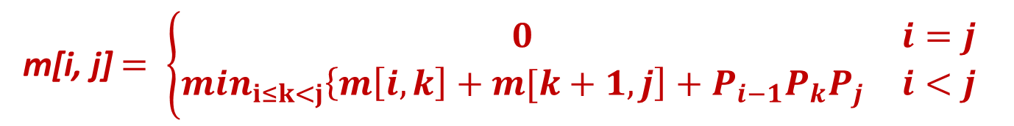
Example 1
m[i, j] $= \left\{\begin{matrix}0 & i=j \\ \min_{i≤k<j}\left\{m\left[i, k\right]+m[k+1, j\right]+P_{i−1}P_{k}P_{j} & i<j\end{matrix}\right.$
 | 1 | 2 | 3 | 4 | 5 | 6
6 | 15125 | 10500 | 5375 | 3500 | 5000 | 0
5 | 11875 | 7125 | 2500 | 1000 | 0
4 | 9375 | 4375 | 750 | 0
3 | 7875 | 2625 | 0
2 | 15750 | 0
1 | 0
 | 1 | 2 | 3 | 4 | 5
6 | 3 | 3 | 3 | 5 | 5
5 | 3 | 3 | 3 | 4
4 | 3 | 3 | 3
3 | 1 | 2
2 | 1
P₀ = 30
P₁ = 35
P₂ = 15
P₃ = 5
P₄ = 10
P₅ = 20
P₆ = 25
m - table
s – table
(Split Table)

Slide 41
Algorithm
O(N³)

Slide 42
Printing optimal solution
 | 1 | 2 | 3 | 4 | 5
6 | 3 | 3 | 3 | 5 | 5
5 | 3 | 3 | 3 | 4
4 | 3 | 3 | 3
3 | 1 | 2
2 | 1
PRINT-OPT-PARENS(s, i, j)
if i = j
then print “A”_{i}
else print “(”
PRINT-OPT-PARENS(s, i, s[i, j])
PRINT-OPT-PARENS(s, s[i, j] + 1, j)
print “)”
S, 1, 6
(
S, 4, 6
)
S, 1, 3
(
)
)
S, 1, 1
S, 2, 3
(
S, 4, 5
S, 6, 6
A₆
A₁
(
(
)
S, 2, 2
S, 3, 3
)
S, 4, 4
S, 5, 5
A₂
A₃
A₄
A₅
((A₁(A₂A₃))((A₄A₅)A₆))

Slide 43
Example 2
Consider the chain of 4 matrices with the size 30, 35, 10, 15, 12.
A1 – 30 x 35
A2 – 35 x 10
A3 – 10 x 15
A4 – 15 x 12
P₀ = 30
P₁ = 35
P₂ = 10
P₃ = 15
P₄ = 12

Slide 44
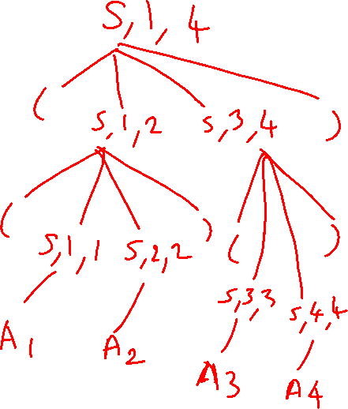
Example 1
 | 1 | 2 | 3 | 4
4 | 15900 | 6000 | 1800 | 0
3 | 15000 | 5250 | 0
2 | 10500 | 0
1 | 0
 | 1 | 2 | 3 | 4
4 | 2 | 2 | 3
3 | 2 | 2
2 | 1
m - table
s - table
((A₁A₂)(A₃A₄))

Slide 45
Longest Common Subsequence
Given two sequences
X = ⟨x₁, x₂, …, x_{m}⟩
Y = ⟨y₁, y₂, …, y_{n}⟩
find a maximum length common subsequence (LCS) of X and Y
E.g.:
X = ⟨A, B, C, B, D, A, B⟩
Subsequences of X:
A subset of elements in the sequence taken in order
⟨A, B, D⟩, ⟨B, C, D, B⟩, etc.

Slide 46
Example
X = ⟨A, B, C, B, D, A, B⟩ X = ⟨A, B, C, B, D, A, B⟩
Y = ⟨B, D, C, A, B, A⟩ Y = ⟨B, D, C, A, B, A⟩
⟨B, C, B, A⟩ and ⟨B, D, A, B⟩ are longest common subsequences of X and Y (length = 4)
⟨B, C, A⟩, however is not a LCS of X and Y

Slide 47
Brute-Force Solution
For every subsequence of X, check whether it’s a subsequence of Y
There are 2^{m} subsequences of X to check
Each subsequence takes Θ(n) time to check
scan Y for first letter, from there scan for second, and so on
Running time: Θ(n2^{m})

Slide 48
Making the choice
Scenario 1
X = ⟨A, B, D, E⟩
Y = ⟨Z, B, E⟩
Choice: include one element into the common sequence (E) and solve the resulting subproblem
X = ⟨A, B, D, G⟩
Y = ⟨Z, B, D⟩
Choice: exclude an element from a string and solve the resulting subproblem
Scenario 2

Slide 49
Notations
Given a sequence X = ⟨x₁, x₂, …, x_{m}⟩ we define the i-th prefix of X, for i = 0, 1, 2, …, m
X_{i} = ⟨x₁, x₂, …, x_{i}⟩
c[i, j] = the length of a LCS of the sequences X_{i} = ⟨x₁, x₂, …, x_{i}⟩ and Y_{j} = ⟨y₁, y₂, …, y_{j}⟩

Slide 50
A Recursive Solution
Case 1: x_{i} = y_{j}
e.g.: X_{i} = ⟨A, B, D, E⟩
Y_{j} = ⟨Z, B, E⟩
Append x_{i} = y_{j} to the LCS of X_{i-1} and Y_{j-1}
Must find a LCS of X_{i-1} and Y_{j-1} ⇒ optimal solution to a problem includes optimal solutions to subproblems
c[i, j] =
c[i - 1, j - 1] + 1

Slide 51
A Recursive Solution
Case 2: x_{i} ≠ y_{j}
e.g.: X_{i} = ⟨A, B, D, G⟩
Y_{j} = ⟨Z, B, D⟩
Must solve two problems
find a LCS of X_{i-1} and Y_{j}: X_{i-1} = ⟨A, B, D⟩ and Y_{j} = ⟨Z, B, D⟩
find a LCS of X_{i} and Y_{j-1}: X_{i} = ⟨A, B, D, G⟩ and Y_{j} = ⟨Z, B⟩
Optimal solution to a problem includes optimal solutions to subproblems
c[i, j] =
max { c[i - 1, j], c[i, j-1] }

Slide 52
Overlapping Subproblems
To find a LCS of X and Y
we may need to find the LCS between X and Y_{n-1} and that of X_{m-1} and Y
Both the above subproblems has the subproblem of finding the LCS of X_{m-1} and Y_{n-1}
Subproblems share subsubproblems

Slide 53
Computing the Length of the LCS
0 if i = 0 or j = 0
c[i, j] = c[i-1, j-1] + 1 if x_{i} = y_{j}
max(c[i, j-1], c[i-1, j]) if x_{i} ≠ y_{j}
0
1
2
n
y_{j:}
y₁
y₂
y_{n}
0
x_{i}
0 | 0 | 0 | 0 | 0 | 0
0
0
0
0
0
1
x₁
first
2
x₂
second
i
m
x_{m}
j

Slide 54
Additional Information
0 if i,j = 0
c[i, j] = c[i-1, j-1] + 1 if x_{i} = y_{j}
max(c[i, j-1], c[i-1, j]) if x_{i} ≠ y_{j}
A matrix b[i, j]:
For a subproblem [i, j] it tells us what choice was made to obtain the optimal value
If x_{i} = y_{j}
b[i, j] = “ ”
Else, if c[i - 1, j] ≥ c[i, j-1]
b[i, j] = “ ↑ ”
else
b[i, j] = “ ← ”
b & c:
0
1
2
3
n
y_{j:}
A
C
D
F
0
x_{i}
0 | 0 | 0 | 0 | 0 | 0
0
0
0
0
0
1
A
2
B
c[i-1,j]
i
3
C
c[i,j-1]
m
D
j

Slide 55
LCS-LENGTH(X, Y, m, n)
The length of the LCS if one of the sequences
is empty is zero
for i ← 1 to m
do c[i, 0] ← 0
for j ← 0 to n
do c[0, j] ← 0
for i ← 1 to m
do for j ← 1 to n
do if x_{i} = y_{j}
then c[i, j] ← c[i - 1, j - 1] + 1
b[i, j ] ← “ ”
else if c[i - 1, j] ≥ c[i, j - 1]
then c[i, j] ← c[i - 1, j]
b[i, j] ← “↑”
else c[i, j] ← c[i, j - 1]
b[i, j] ← “←”
return c and b
Case 1: x_{i} = y_{j}
Case 2: x_{i} ≠ y_{j}
Running time: Θ(mn)

Slide 56
Example 1
0 if i = 0 or j = 0
c[i, j] = c[i-1, j-1] + 1 if x_{i} = y_{j}
max(c[i, j-1], c[i-1, j]) if x_{i} ≠ y_{j}
X = ⟨A, B, C, B, D, A, B⟩
Y = ⟨B, D, C, A, B, A⟩
0
1
2
3
4
5
6
If x_{i} = y_{j}
b[i, j] = “ ”
Else if c[i - 1, j] ≥ c[i, j-1]
b[i, j] = “ ↑ ”
else
b[i, j] = “ ← ”
y_{j}
B
D
C
A
B
A
0
x_{i}
0
0
0
0
0
0
0
1
A
0
↑
0
↑
0
↑
0
1
1
←1
2
B
0
1
↑
1
2
←1
←1
←2
3
C
0
↑
1
↑
1
2
↑
2
↑
2
←2
4
B
0
1
↑
1
↑
2
↑
2
3
←3
5
D
0
↑
1
2
↑
2
↑
2
↑
3
↑
3
6
A
0
↑
1
↑
2
↑
2
3
↑
3
4
7
B
0
1
↑
2
↑
2
↑
3
4
↑
4

Slide 57
Constructing a LCS
Start at b[m, n] and follow the arrows
When we encounter a “ “ in b[i, j] ⇒ x_{i} = y_{j} is an element of the LCS
0
1
2
3
4
5
6
y_{j}
B
D
C
A
B
A
0
x_{i}
0
0
0
0
0
0
0
1
A
0
↑
0
↑
0
↑
0
1
1
←1
2
B
0
1
↑
1
2
←1
←1
←2
3
C
0
↑
1
↑
1
2
↑
2
↑
2
←2
4
B
1
↑
1
↑
2
↑
2
3
Solution: BCBA
0
←3
5
D
0
↑
1
2
↑
2
↑
2
↑
3
↑
3
6
A
0
↑
1
↑
2
↑
2
3
↑
3
4
7
B
0
1
↑
2
↑
2
↑
3
4
↑
4

Slide 58
PRINT-LCS(b, X, i, j)
if i = 0 or j = 0
then return
if b[i, j] = “ ”
then PRINT-LCS(b, X, i - 1, j - 1)
print x_{i}
elseif b[i, j] = “↑”
then PRINT-LCS(b, X, i - 1, j)
else PRINT-LCS(b, X, i, j - 1)
Initial call: PRINT-LCS(b, X, length[X], length[Y])
Running time: Θ(m + n)

Slide 59
Example 2
X = ABCABA Y = BACBCA
X/Y |  | 0 | 1 | 2 | 3 | 4 | 5 | 6
 |  | Y_{i} | B | A | C | B | C | A
0 | X_{i} | 0 | 0 | 0 | 0 | 0 | 0 | 0
1 | A | 0 | 0 | 1 | 1 | 1 | 1 | 1
2 | B | 0 | 1 | 1 | 1 | 2 | 2 | 2
3 | C | 0 | 1 | 1 | 2 | 2 | 3 | 3
4 | A | 0 | 1 | 2 | 2 | 2 | 3 | 4
5 | B | 0 | 1 | 2 | 2 | 3 | 3 | 4
6 | A | 0 | 1 | 2 | 2 | 3 | 3 | 4
Solution: ABCA

Slide 60
Coin Changing Problem
Given a value N, if we want to make change for N cents, and we have infinite supply of each of S = { S1, S2, .. , Sm} valued coins, how many ways can we make the change? The order of coins doesn’t matter. Find the minimum number of coins to change.
For example, for N = 4 and S = {1,2,3}, there are four solutions: {1,1,1,1}, {1,1,2}, {2,2}, {1,3}. So output should be 4. Minimum is 2.
For N = 10 and S = {2, 5, 3, 6}, there are five solutions: {2,2,2,2,2}, {2,2,3,3}, {2,2,6}, {2,3,5} and {5,5}. So the output should be 5. Minimum is 2.

Slide 61
Greedy Fails!!
Assume the coins available as {30, 20, 5, 1}, how many ways you can make the change for the amount 40?
Using greedy, Solution is {30, 5, 5}. So the total coins are 3.
But actually, solution could be {20, 20} with 2 coins.
Greedy algorithm fails in such cases as it fails to give an optimal solution.
Dynamic programming approach can be used to get an optimal solution.

Slide 62
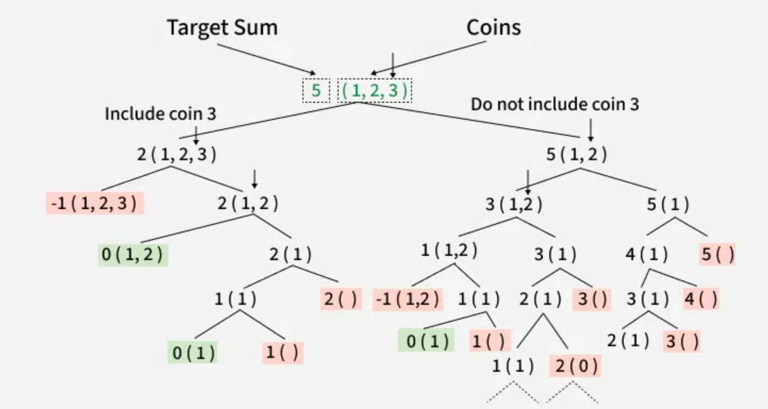
Naïve approach – using Recursion
For each coin, there are two possibilities:
Include the current coin If we pick the current coin, then its value reduces the remaining target sum. Because coins are available in infinite supply, we can include the same coin again. So the recursive call becomes: count(coins, n, sum - coins[n-1])
Exclude the current coin If we decide not to pick the current coin, then we move to the previous coin while keeping the target sum unchanged. So the recursive call becomes: count(coins, n-1, sum)
Using Recursion - O(2^sum) time and O(sum) space

Slide 63
DP Solution – using Memoization (Bottomup DP)
function coinChange(coins, V):
dp[0] = 0
lastCoin[0] = -1
for i = 1 to V:
dp[i] = ∞
lastCoin[i] = -1
for i = 1 to V:
for each coin c in coins:
if c <= i:
dp[i] = min(dp[i], dp[i-c] + 1)
lastCoin[i] = c (c corresponding to min value)
if dp[V] == ∞:
return -1
else:
return dp[V]
DP Solution:
dp[0]=0 (Base case)
dp[i]=min(dp[i−c]+1)for all c≤i
Time: O(n × V), Space: O(V)

Slide 64
Example 1
Find the minimum number of coins to change a total amount V = 6, using the denomination coins, {1, 3, 4}
Initially:
i (amount) | 0 | 1 | 2 | 3 | 4 | 5 | 6
dp[i] | 0 | ∞ | ∞ | ∞ | ∞ | ∞ | ∞
LastCoin | -1 | -1 | -1 | -1 | -1 | -1 | -1
i = 1
Try all coins:
coin 1 → dp[1] = dp[1−1] + 1 = dp[0] + 1 = 1
coin 3, 4 → not possible
i | 0 | 1 | 2 | 3 | 4 | 5 | 6
dp[i] | 0 | 1 | ∞ | ∞ | ∞ | ∞ | ∞
lC | -1 | 1 | -1 | -1 | -1 | -1 | -1

Slide 65
Example 1 - Contd
i | 0 | 1 | 2 | 3 | 4 | 5 | 6
dp[i] | 0 | 1 | 2 | ∞ | ∞ | ∞ | ∞
lC | -1 | 1 | 1 | -1 | -1 | -1 | -1
i = 2
coin 1 → dp[2] = dp[1] + 1 = 2
coin 3, 4 → not possible
i = 5
coin 1 → dp[4] + 1 = 2
coin 3 → dp[2] + 1 = 3
coin 4 → dp[1] + 1 = 2
i = 3
coin 1 → dp[2] + 1 = 3
coin 3 → dp[0] + 1 = 1
coin 4 → not possible
i | 0 | 1 | 2 | 3 | 4 | 5 | 6
dp[i] | 0 | 1 | 2 | 1 | ∞ | ∞ | ∞
lC | -1 | 1 | 1 | 3 | -1 | -1 | -1
i | 0 | 1 | 2 | 3 | 4 | 5 | 6
dp[i] | 0 | 1 | 2 | 1 | 1 | 2 | ∞
lC | -1 | 1 | 1 | 3 | 4 | 1 | -1
i = 4
coin 1 → dp[3] + 1 = 2
coin 3 → dp[1] + 1 = 2
coin 4 → dp[0] + 1 = 1
i | 0 | 1 | 2 | 3 | 4 | 5 | 6
dp[i] | 0 | 1 | 2 | 1 | 1 | ∞ | ∞
lC | -1 | 1 | 1 | 3 | 4 | -1 | -1

Slide 66
Example 1 - Contd
i = 6
coin 1 → dp[5] + 1 = 3
coin 3 → dp[3] + 1 = 2
coin 4 → dp[2] + 1 = 3
Identify the Coins
Start from V = 6:
6 → lastCoin[6] = 3 → remaining = 3 3 → lastCoin[3] = 3 → remaining = 0
Coins used = {3, 3}
i | 0 | 1 | 2 | 3 | 4 | 5 | 6
dp[i] | 0 | 1 | 2 | 1 | 1 | 2 | 2
lC | -1 | 1 | 1 | 3 | 4 | 1 | 3
No. of Ways we can change the coin is dp[6]
(i.e.) V[6] = 2 Coins

Slide 67
Example 2
Assume the coins available as {1, 5, 6, 9}, how many ways you can make the change for the amount 11?
Greedy Solution: 9, 1, 1 (3 coins)
Actual Solution: 6, 5 (2 coins)
Total Number of ways: dp[11] = 2 Coins
Denominations: {5, 6}
i | 0 | 1 | 2 | 3 | 4 | 5 | 6 | 7 | 8 | 9 | 10 | 11
dp[i] | 0 | 1 | 2 | 3 | 4 | 1 | 1 | 2 | 3 | 1 | 2 | 2
lastCoin | -1 | 1 | 1 | 1 | 1 | 5 | 6 | 1 | 1 | 9 | 1 | 5

Slide 68
Example 3
Assume the coins available as {30, 20, 5, 1}, how many ways you can make the change for the amount 40?
Need an array of size 40 to work with

